Slide 1


CAR RENTAL SERVICE USING BLOCKCHAIN
By ARDHRA P R
S4 MCA -A

Slide 2


Contents
Relevance of Topic
Description of the Project
Objective of the study
Existing System and Proposed System
Input/Output and Modules Identified
Description of Methodology

Slide 3
Relevance of Topic
Car rental and leasing sectors are growing worldwide, driven by rising technological advancements in transportation and increased need for ease of mobility. A shift in demand from car ownership to car sharing is driving the growth in car rental and leasing industries.
When people need a car for some reason, they prefer renting it for a short duration rather than buying it. With the coming of the digital era, these services have been infused with technology. Now users of this industry can look at various options on websites or mobile applications. Technology has also increased the ease of doing business in this field as people can now track cars with Global Positioning Systems (GPS).

Slide 4
Description of the Project
The project is a car rental application were based on blockchain technology. This is mainly designed for people who can both give their car for rent and also rent other’s car since it is a decentralized application. Crypto currencies are used for transaction. The location of the car which was taken for rent is also available in this application. In this project, how blockchain used for the transaction of car rental services that will be beneficial for both the car owner and the renter. The platform is cost optimal because there will be no intermediary in between.

Slide 5
Objectives of the Study
A lot of problems can be solved using a distributed peer-to-peer network. Such a network can significantly reduce the commissions charged by the middleman. This will also encourage a lot of people to rent out their car with ease when it is not in use. This is a significant problem with car rental services in the present times. If a person wants to rent a car, and his neighbor’s car is not being used, he still has to go all the way to the rental service, to a middleman, to rent a car. Questions can be raised about the regulatory compliances in the absence of a central authority. How blockchain can be used to bring about a revolution in the industry.

Slide 6
Existing System and Proposed System
Existing System
The process of renting a car is highly centralized, where the car rental company being the main point of contact for the user to rent cars. Car rental companies need to maintain a fleet of cars, as well as car stations and staff to efficiently run their operations, which makes up for bulk of their operating costs. Car rental companies cover these costs from (high) rental rates charged to their customers.

Slide 7
DRAWBACKS IN EXISTING PLATFORMS
High expenses
No transparency
Centralized Structure
Absence of trust

Slide 8
Proposed System
A android application is made for renting cars. Anyone give their car for rent and also book others car for rent. After the car is rented the location of the car will be visible.The basic data structure of this project is the blockchain which is a growing list of records called blocks, which are linked using cryptography. Blocks in our blockchain will represent the transaction made during the renting of the car.

Slide 9
Input/Output and Modules Identified
Car Owner Registration
As a car owner, I want to be able to list a car for rent to be rented
Complete the fields within the UI
Click the ‘Add car’ button to add the car
The newly added car listing will appear and be available

Slide 10
Customer Registration
As a user, I want to be able to see which cars are listed and rent an available one.
Find a car that listed as available
Press the rent button
You will be marked as the current renter of the car.
Payment Transaction
The transaction fees will be very less compared to other car rental platforms.
Once the terms of the smart contract are met, payments are automatically transferred in the form of cryptocurrency or tokens purchased while registering.

Slide 11
Location Tracking
Technology has increased the ease of doing business in the field as people can now track cars with Google APIs.

Slide 12
Description of Methodology
There are a lot of drawbacks in existing car rental platforms. Each of those can be solved using blockchain.
The problem of trust can be solved using blockchain.
Once a transaction is recorded in a block, it cannot be tampered as the hash computed for a block contains the previous block hash .
So if transaction is tampered, then all the subsequent block hashes will have to be recomputed which requires a tremendous amount of computation power.
Blockchain is completely decentralized, so the money and power will remain in the hands of the masses .
Over and above, there will be no unnecessary commissions going to big corporations.
Transaction details will be secured using cryptography and will not be shared with third parties as the traditional companies do for monetary benefits .
This will result in less spamming to the users of the platform.

Slide 13

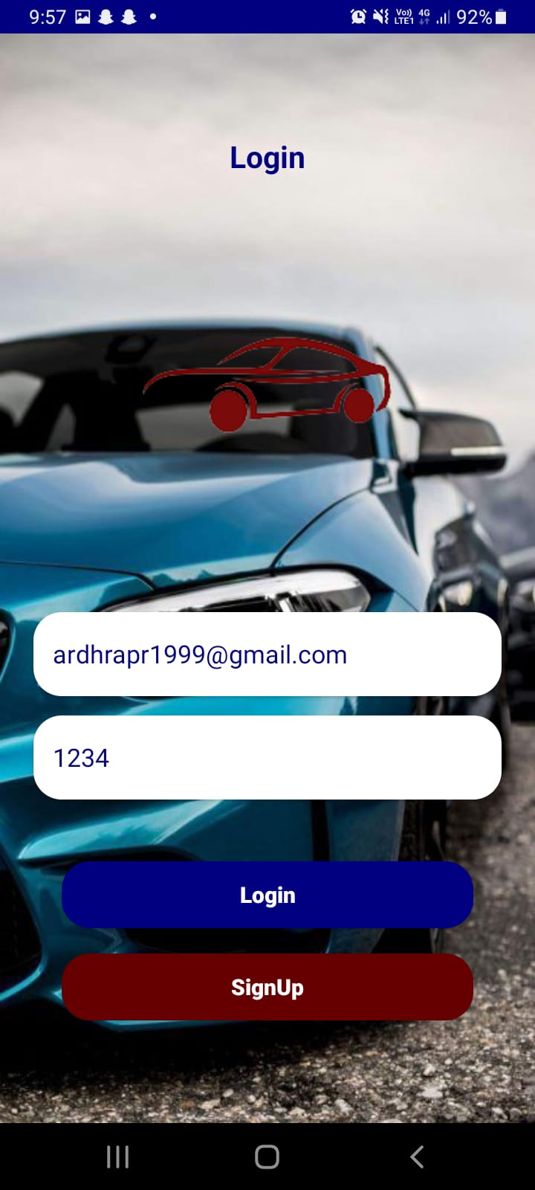
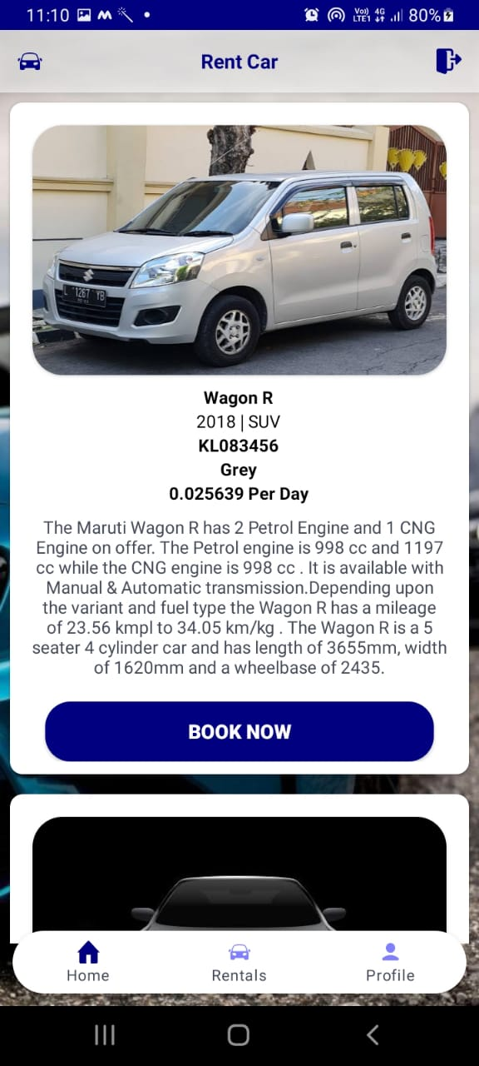
SCREENSHOTS

Slide 14
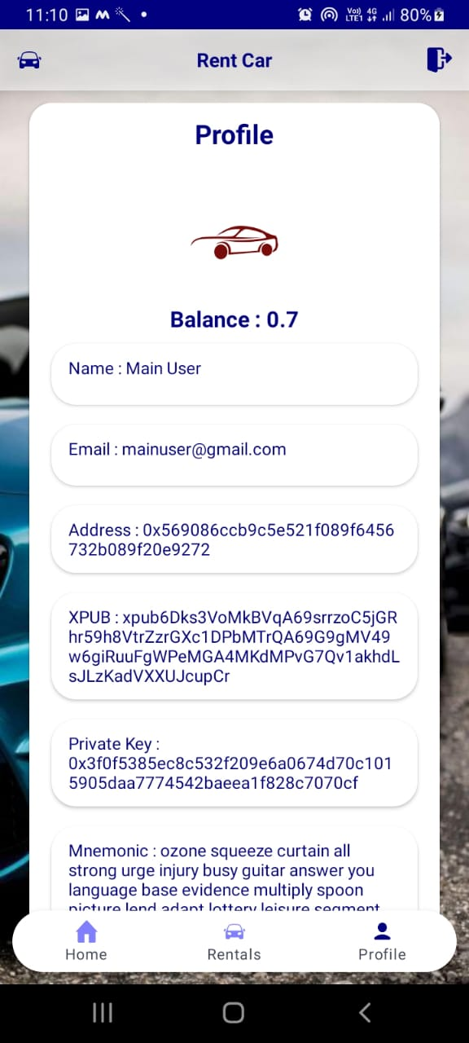
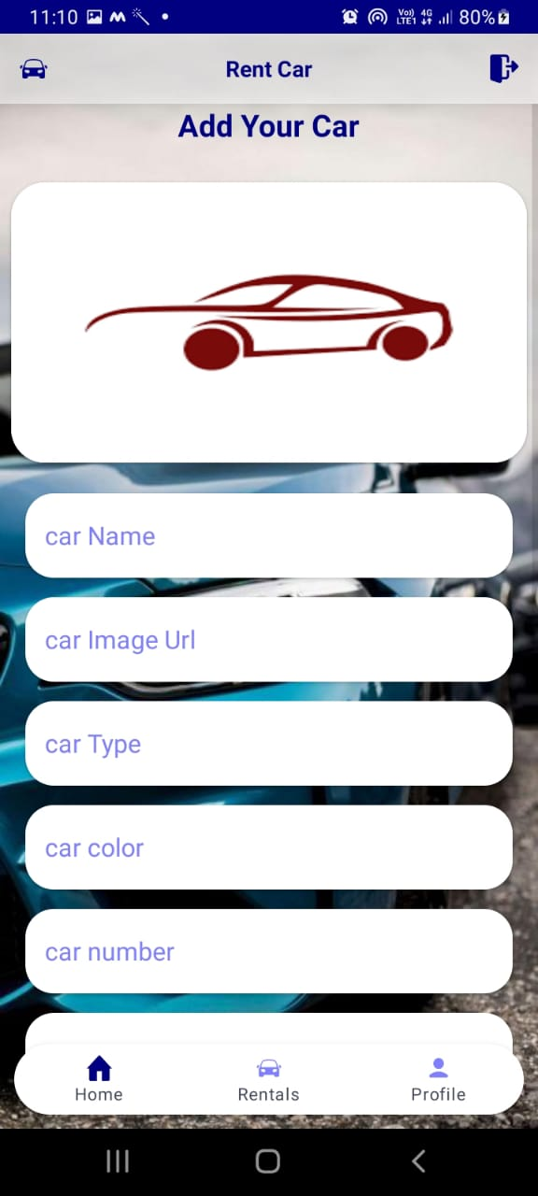
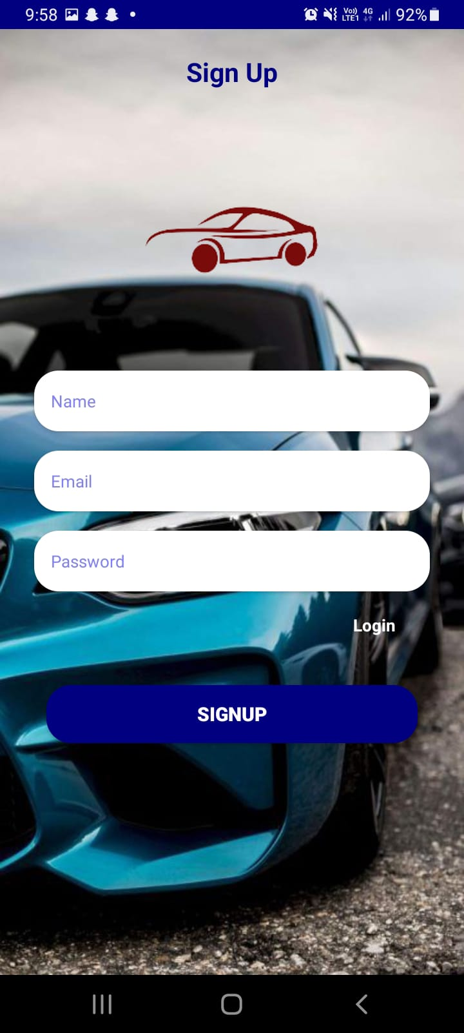

Slide 15
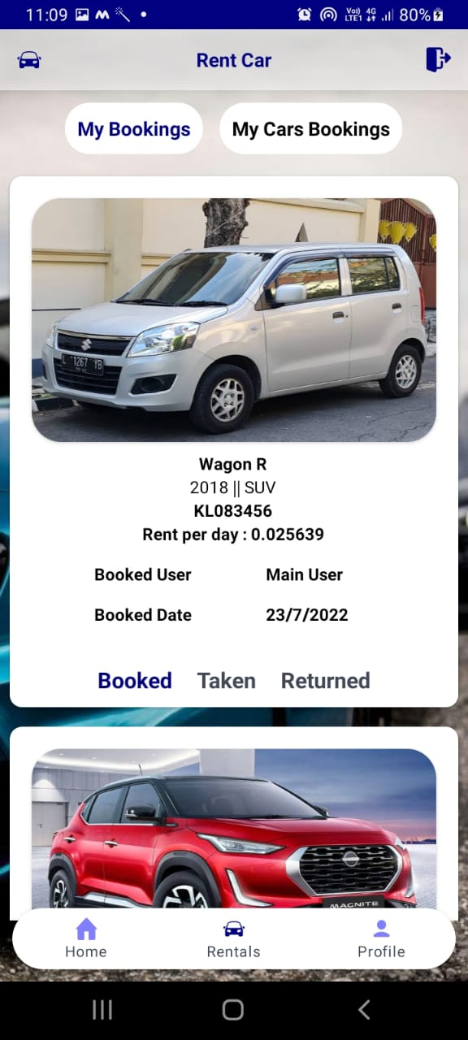
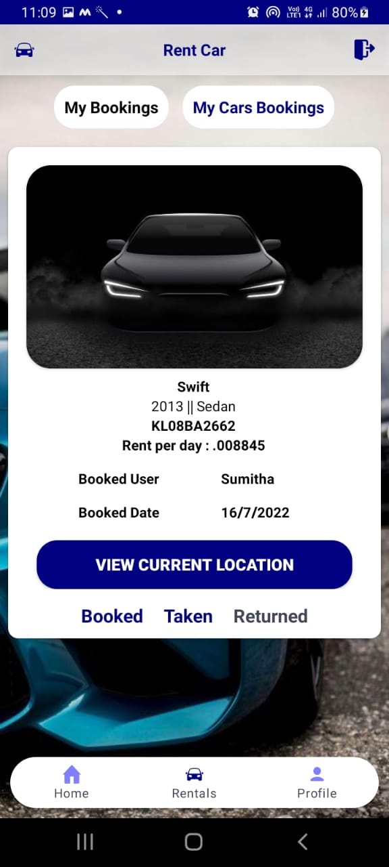
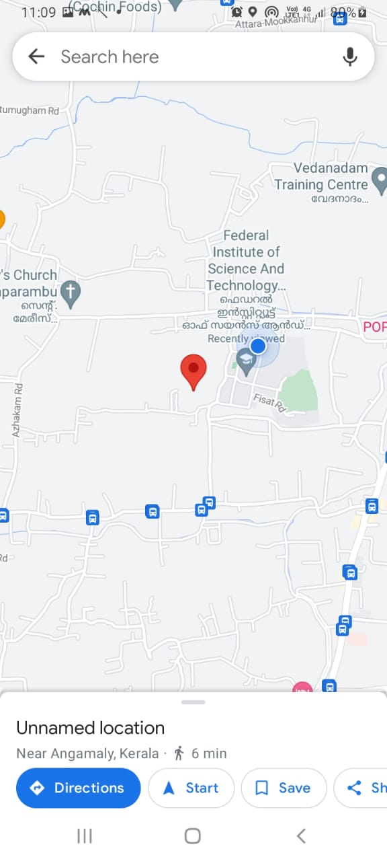

Slide 16

THANK YOU

